Slide 1
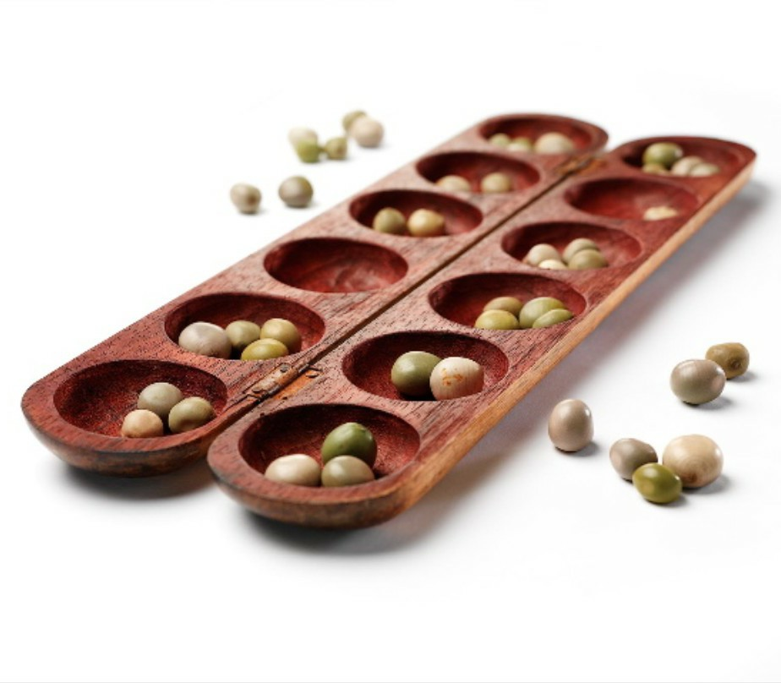
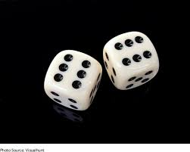
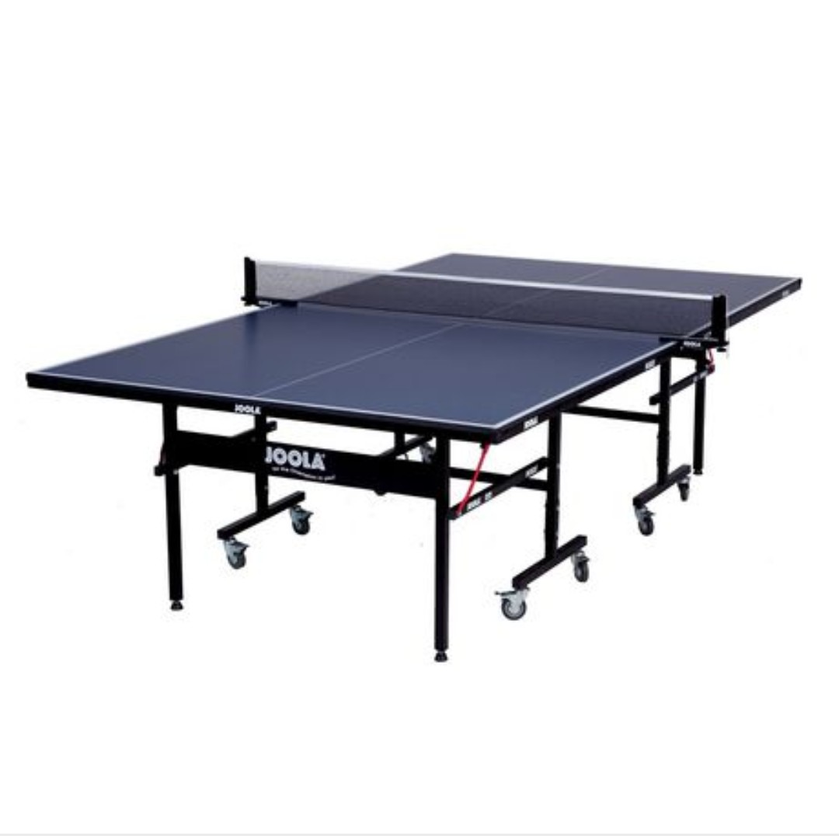
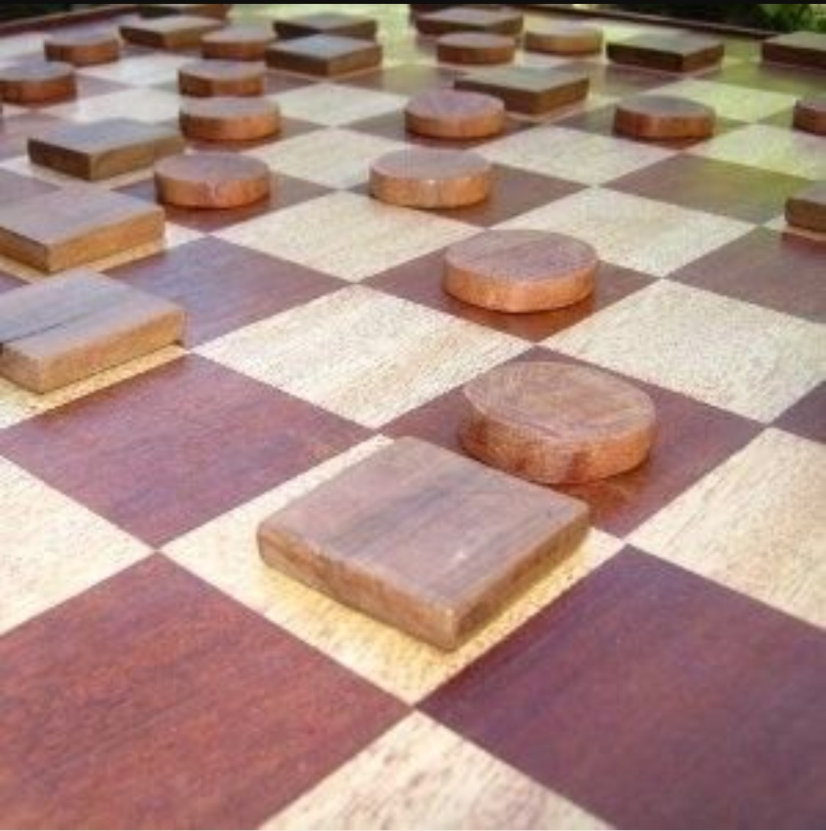
THE GHANA GAME CHAMPIONSHIP

Slide 2
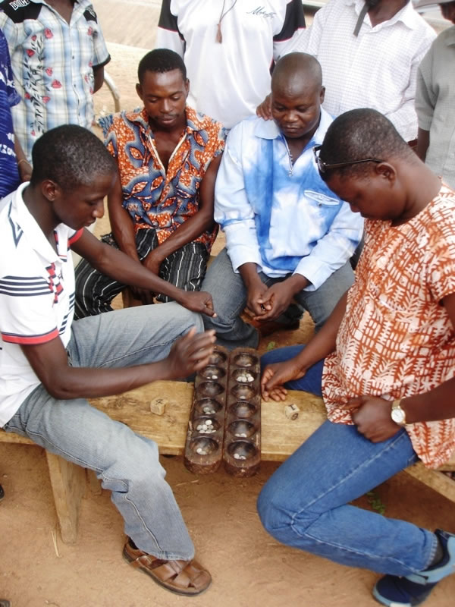
CONCEPT
The Ghana Game Championship is a television programme that would show case games in different communities within the Greater Accra Region by selecting people to play four games (Oware, ludo, drafts and table tennis).
The individuals from targeted communities would come together and compete for one trophy.
A winner will emerge after every section and there would be a grand finale that will hunt for the master of the game by bringing all the winners together to play the sections of the game.

Slide 3
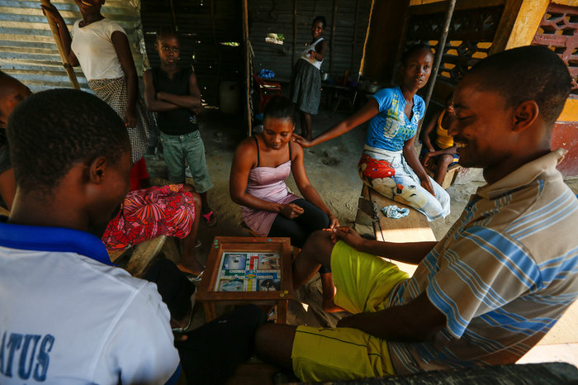
TARGET AUDIENCE
The target audience are the indigenes within some selected communities of the Greater Accra Region from 16-50 years.
We believe for the local games to be enjoyed and well passed on, through healthy competition.
They would take the young ones on a ride to the memory lane. It would be enjoyed by all.

Slide 4
SELECTED COMMUNITIES
Labadi Roman Park
Kasoa Market
Madina Zongo
Teshie Salem Park
Korle Gonno Dr. Bannerman Park
Banana – Inn
Kotobabi Wembley
Alajo Polo Park
Nyaneba Methodist
Jamestown Mantse Agbona
The communities have been selected as part of the set up of the Ghana Game Championship to choose communities from the Greater Accra Region for its maiden edition.
The selected communities are made of indigenous people who are familiar with, and enjoy those games. The mission is to find those who are best at it. For bragging rights and a title.

Slide 5
SELECTION PROCESS
Indigenes interested in the game would be required to pick up registration forms at the cost of 5ghc per form.
A day will be picked to wrap up the registration process.
Participants who win each game shall be sustained for the next level.
The master of the game will be determined on the grand finale. This will done by putting together winners from the previous week’s games for them to play.

Slide 6
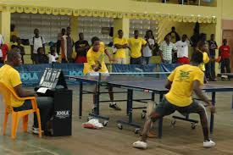
HOW THE GAMES WILL BE PLAYED
Oware, drafts and ludo will be based on knock out.
Table tennis will be an “all play all” game depending on the number
Winners emerging from all the communities will converge on the day of the grand finale to battle it out.
There would be four winners after the competition.

Slide 7
OBJECTIVES
The Ghanaian game show will foster unity among indigenes and familiarization through interaction.
To preserve the Ghanaian game culture.

Slide 8
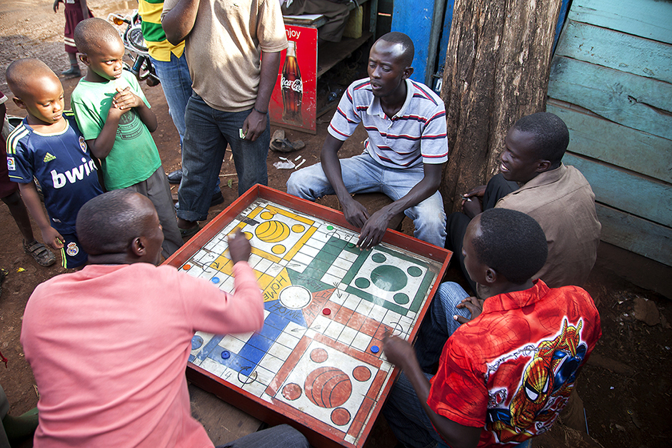
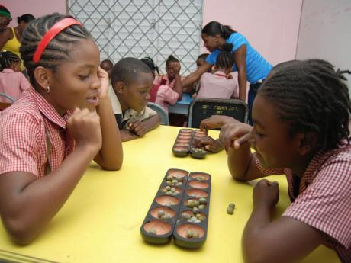
DAY, TIME AND DURATION
The programme will run every Saturday for 3 months.
The proposed time is from 10:00am to 4:00pm.

Slide 9
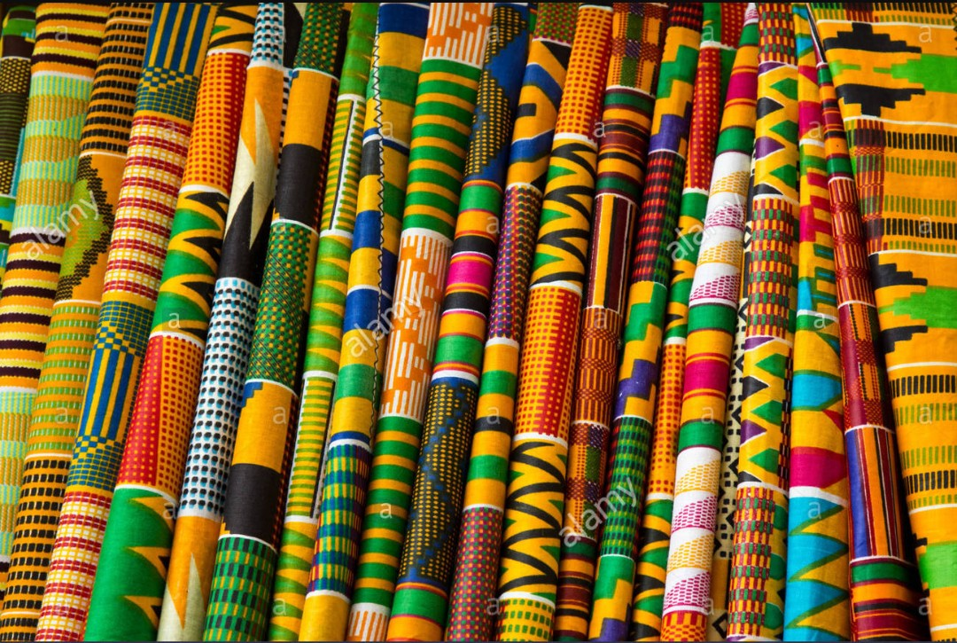
THE GAME’S SETTING
LOCATION
SET UP
The location for the games would be the communities mentioned in the baove slide.
A logo should be designed for the Ghanaian game show.
A kente should be used for a pull-up banners which will be erected at the location for easy identification.

Slide 10

AWARENESS CREATION
Production of promotional advertisements on televisions, jingles for radio.
Employing the services of the Information Services Department van would also help in creating awareness.
Influencers in the communities (town criers, Assemblymen and Chiefs) would be a key tool for promoting the championship in the communities.
Using tag lines and hash tags before and during the programme on social media would also inform the general public and promote our brand.

Slide 11










SPONSORS
The Ghanaian game show would have sponsors and investors come on board to contribute their quota in making the show and maintaining or improving its standards.
The proposed sponsors are MTN, Stanbic bank, Perk biscuit and Twellium Industrial Company Limited, producers of Verna Mineral water, Planet, Blow Group of Companies producers of bel-aqua and beverages, Fan Milk Ghana Limited, Vitamilk, Promasidor, Yomi yogurt, Kasapreko Ghana Limited, etc.
The show is also open to individuals who are passionate about Ghanaian games as an aspect of the culture and who in the best place to invest into it.

Slide 12
CONCLUSION
The Ghana Game Championship will be successful if the above strategies are taken into consideration.
When the objectives are achieved, Ghanaian games would have a positive light within and outside the Ghanaian communities.

Slide 13
END
THANK YOU

